Slide 1


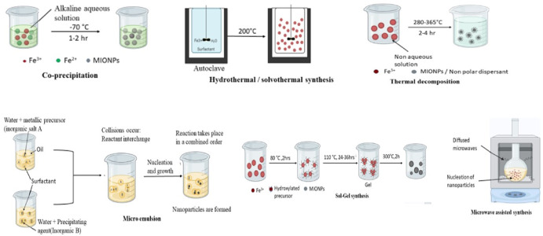
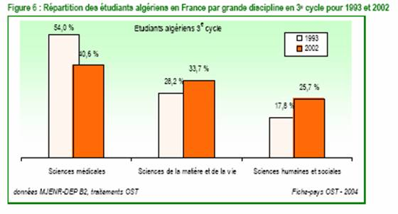
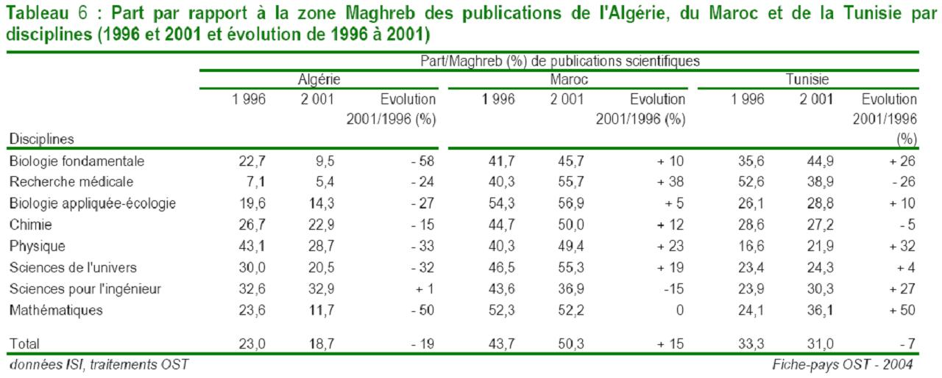
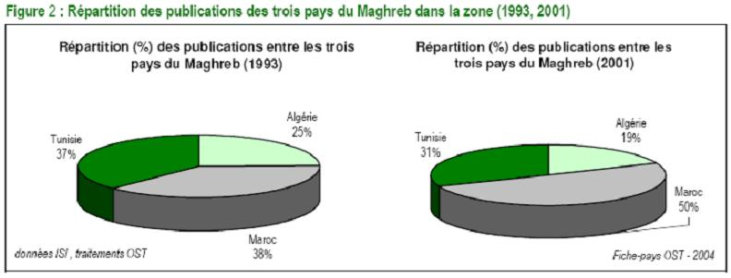


Write Your Title Here - Write Your Title Here -
Write Your Title Here - Write Your Title Here -
Author(1), Author(2), Author(2), …
Put (*) Just After the Corresponding Author’s Name
Corresponding’s Author Email: ……..
Poster ID
…
Abstract
This is my abstract. This is my abstract. This is my abstract. This is my abstract. This is my abstract. This is my abstract. This is my abstract. This is my abstract. This is my abstract. This is my abstract. This is my abstract. This is my abstract. This is my abstract. This is my abstract. This is my abstract. This is my abstract. This is my abstract. This is my abstract. This is my abstract. This is my abstract. This is my abstract. This is my abstract. This is my abstract. This is my abstract. This is my abstract. This is my abstract. This is my abstract. This is my abstract. This is my abstract. This is my abstract.
This is my abstract. This is my abstract. This is my abstract. This is my abstract. This is my abstract. This is my abstract. This is my abstract. This is my abstract. This is my abstract. This is my abstract. Keywords: Keyword1, Keyword2, Keyword3, Keyword4, Keyword5.
Introduction
This is my introduction. This is my introduction. This is my introduction. This is my introduction. This is my introduction. This is my introduction. This is my introduction. This is my introduction. This is my introduction. This is my introduction. This is my introduction. This is my introduction. This is my introduction. This is my introduction. This is my introduction. This is my introduction. This is my introduction. This is my introduction. This is my introduction. This is my introduction. This is my introduction. This is my introduction. This is my introduction. This is my introduction. This is my introduction. This is my introduction. This is my introduction. This is my introduction. This is my introduction. This is my introduction. This is my introduction. This is my introduction. This is my introduction. This is my introduction. This is my introduction. This is my. This is my introduction. This is my introduction. This is my introduction. This is my introduction. This is my introduction. This is my introduction. This is my introduction. This is my introduction. This is my introduction. This is my introduction. This is my introduction. This is my introduction. This is my introduction. This is my introduction. This is my introduction. This is my introduction. This is my introduction. This is my introduction. This is my introduction. This is my introduction. This is my introduction. This is my introduction.
Materials
List the equipment used
List the materials used.
Results & Discussion
Conclusion
This is my conclusion. This is my conclusion. This is my conclusion. This is my conclusion. This is my conclusion. This is my conclusion. This is my conclusion. This is my conclusion. This is my conclusion. This is my conclusion. This is my conclusion. This is my conclusion. This is my conclusion. This is my conclusion. This is my conclusion. This is my conclusion. This is my conclusion. This is my conclusion. This is my conclusion. This is my conclusion. This is my conclusion. This is my conclusion. This is my conclusion. This is my conclusion. This is my conclusion. This is my conclusion. This is my conclusion. This is my conclusion. This is my conclusion. This is my conclusion. This is my conclusion. This is my conclusion. This is my conclusion. This is my conclusion. This is my conclusion. This is my conclusion. This is my conclusion. This is my conclusion. This is my conclusion. This is my conclusion. This is my conclusion. This is my conclusion. This is my conclusion. This is my conclusion. This is my conclusion. This is my conclusion.
References
[1] References. References. References. References. References. References. References. References. References. References. References. References. References. References.
[2] References. References. References. References. References. References. References. References. References. References. References. References. References. References.
[3] References. References. References. References. References. References. References. References. References. References. References. References. References. References.
[4] References. References. References. References. References. References. References. References. References. References. References. References. References. References.
The third Study Day on Applied Chemistry& Environmental Engineering (SDACEE’3)
El Oued – Algeria
April 23, 2026

